Slide 1
Beyond the Words: Predicting User Personality from Heterogeneous Information
张富峥
微软亚洲研究院
https://www.microsoft.com/en-us/research/people/fuzzhang/
fuzzhang@microsoft.com

Slide 2
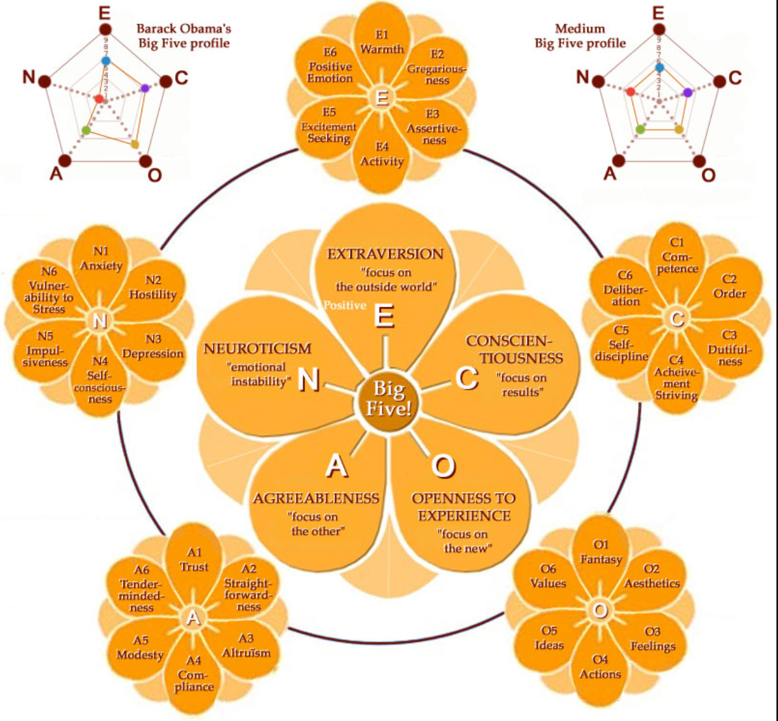
Big 5 Personality
Notes:
When we describe a person, except for some basic profiles such as age, gender and profession, as everyone knows, personality is also very important. For example, you may expect a nice manager, and the company expect a responsible employee. Actually, there are thousands of words to describe a user’s personality, such as nice, responsible. The psychologists have group these personality description into five dimensions, named as Big Five. Each dimension describe a high-level aspect of a person, for example, Extraversion dimension describes whether a user is active in social environment, Agreeableness dimension describes whether a user is nice.

Slide 3
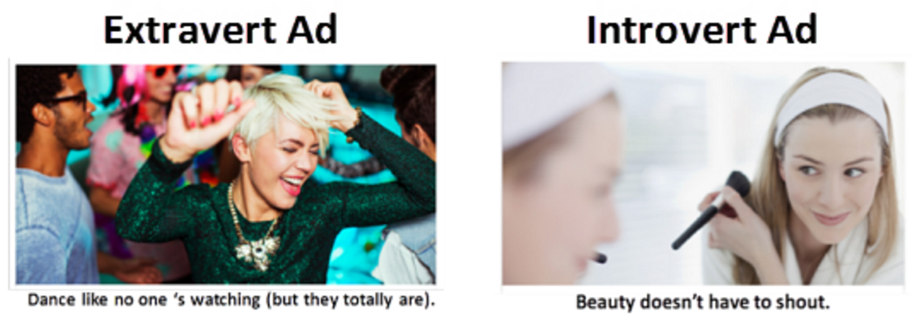
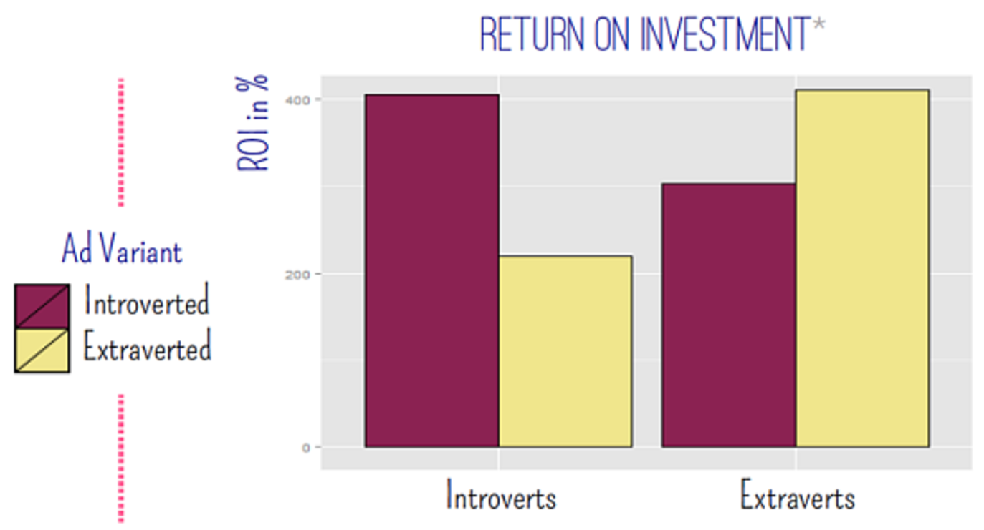
Personality does matter!
Notes:
P. V. S. D. & K. M. Matz S., “Using the Big Five for personality-customised advertising on Facebook,” 16th Annu. Meet. Soc. Personal. Soc. Psychol., 2015.

Slide 4
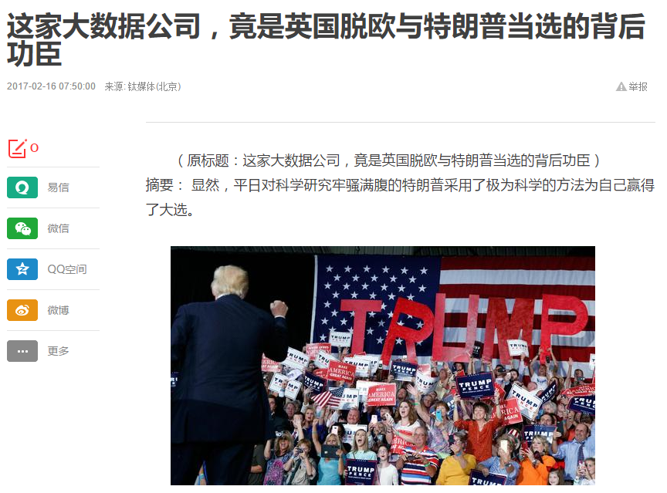
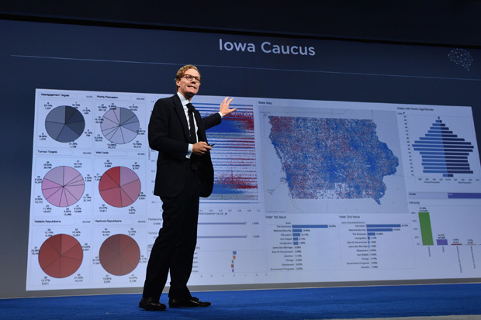
Personality does matter!
Cambridge Analytica公司CEO亚历山大·尼克斯。
Notes:
Trump的数字战略主管
性格分析还能被用来助力美国大选。Trump在2016年6月聘请了一家名为Cambridge Analytica的公司来帮助他竞选，而这家公司的首席执行官Alexander正是Trump的数字战略主管。这家公司立刻就从各种地方购买个人数据，比如土地登记信息、汽车数据、购物数据、优惠券、俱乐部会员，你读什么杂志、去哪个教堂、Facebook 点赞等，再把这些数据与选民名册整合到一起，然后用模型把这些美国成年人分成了32种不同的性格。紧接着，Alexander联系广告公司在Facebook这个平台上发布了17.5万个各不相同的宣传Trump观点的广告。Alexander说：“不同的人看到的广告标题、内容，甚至连颜色和字体都是不同的，这种广告能覆盖哪怕最小的受众群体，甚至具体到个人。” 以枪支使用为例，Alexander展示了如何对特定的选民提供适当的政治讯息：如果是神经质型和严谨型观众，就要突出入室抢劫的威胁，显示政策应该保证业主持枪，所以可以让他们看看这种画面：抢劫者一只砸窗户的手；另一边，要是封闭的亲和型人，他们关心传统、习惯和家庭，不妨给他们看类似大人带着孩子站在夕阳下举枪打野鸭的画面。可以看到，基于性格的广告与目标受众是如此的贴合，以至于改变了很多美国选民的投票意向，甚至可以说这就是一场心理操纵。

Slide 5
Previous Work
Psychology (questionnaire-based) approaches
Surveys or interview-based approaches
Rely heavily on retrospective self-reports
Time costs, money costs, data granularity and etc.
Data-driven methods
Texts, such a Closed vocabulary, Linguistic Inquiry and Word Count(LIWC)
Open vocabulary, Topic Modeling(LDA)
Single feature in user digital traces, such as
Hash-tags and Facebook likes (Mypersonality)
Notes:
Personality plays a key role into our life, so measure personality effectively and efficiently is an important thing.
In the psychology, we can measure user personality by interview or questionnaires, but we know, it relies heavily on self-reports, there maybe cognitive bias or memory error, what is more, these methods can not be applied to a large group of users due to time and finance limitation.
Recently, due the collection of user behavior data, some data-driven methods has been proposed to measure personality. Most of work focus on extracting text-based features. Some work also explore other single-domain feature, such as Facebook likes to predict Big Five.
`

Slide 6
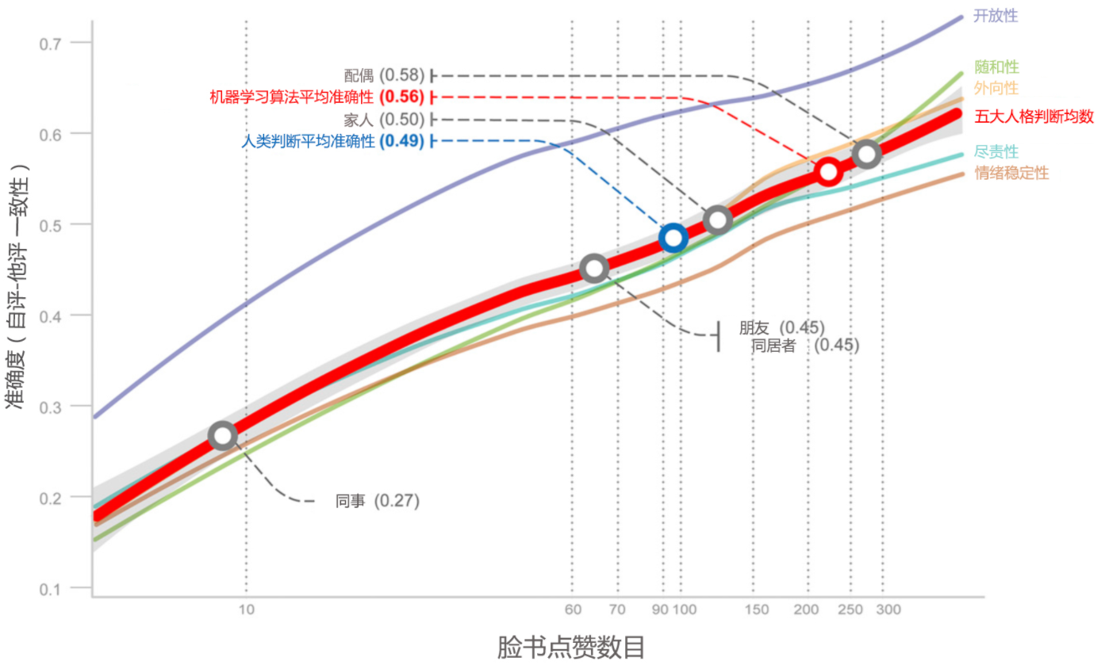

Slide 7
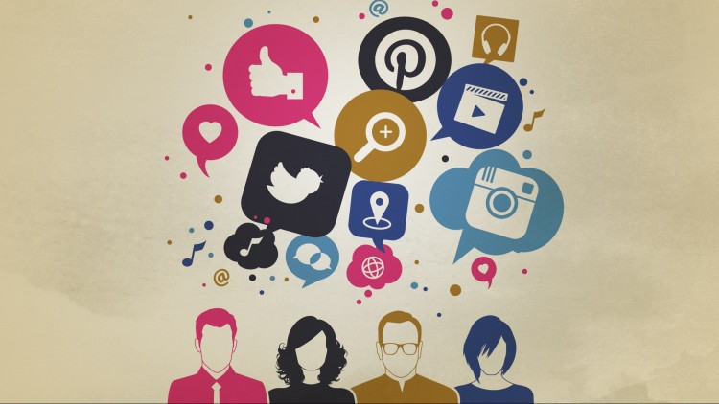
Heterogeneous information on social media
Text
Image
User Interaction
Emoticon
Notes:
Previous work focus on single-domain behavior, however, we know that social media is heterogeneous, there are different kinds of information on social media, there are texts, images, user interactions and emoticons.
Our work focus on how to integrate these information to have a better personality measurement.

Slide 8
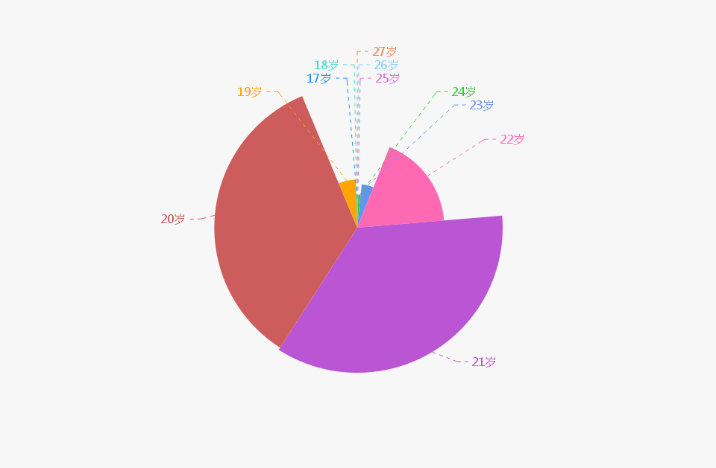
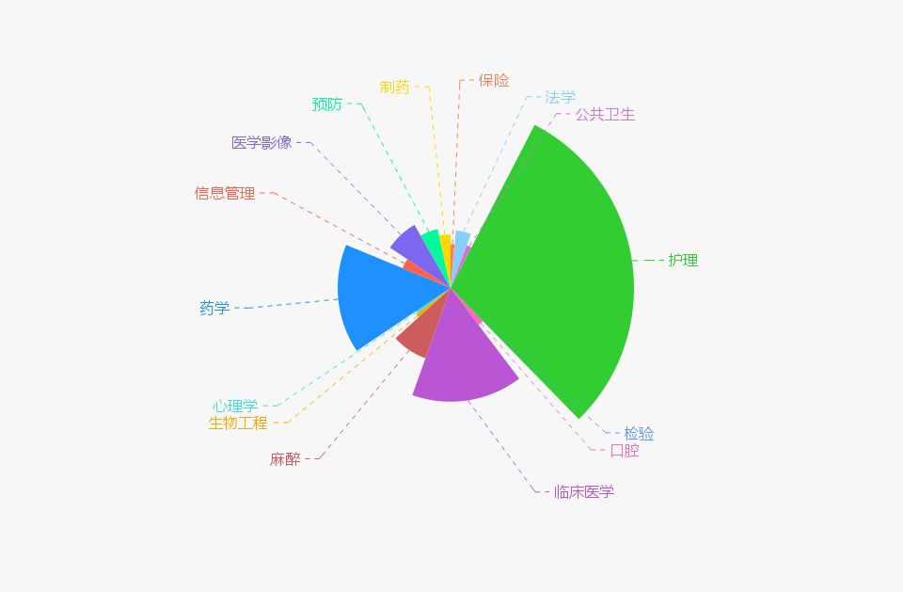
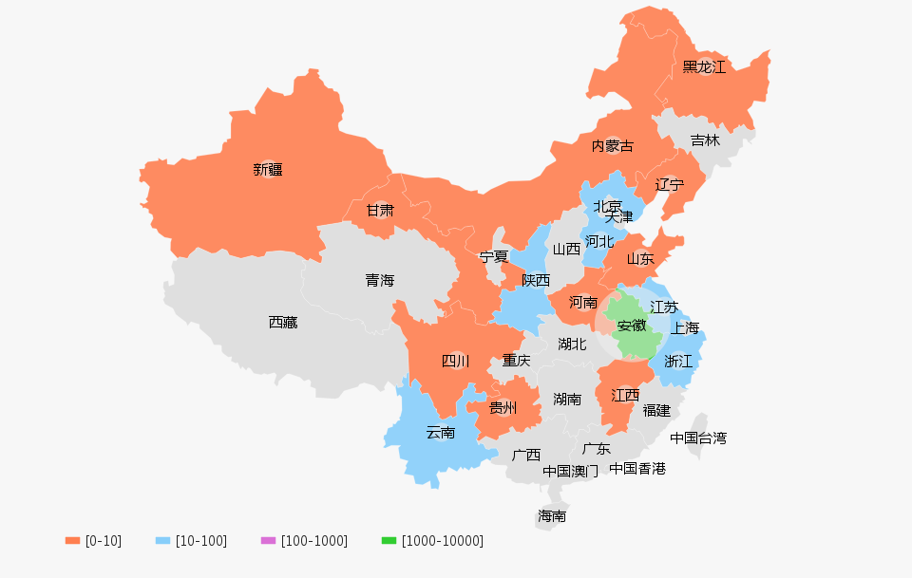
Personality Data
3,162 users in a medical school in Anhui,
Test Big Five Personality with 44-item questionnaire
Extraversion|Agreeableness|Conscientiousness|Neuroticism|Openness
Age: average, 20.84; the majority, from 20 to 22
Gender: Female users are the majority
Major: nursing (n = 524), clinical medicine (n = 365) and pharmaceutics (n = 342)
Ethnicity: Han Chinese and Hui minority
Region: Anhui, Zhejiang, and Jiangsu
Notes:
Our data consists of about 3000 students from a medical school. The students finished a psychology questionnaire as the personality ground-truth, and also provide their social media account, we use API to crawl their social media data. There are some statistics of the student profiles, such as age, gender and major.

Slide 9
Framework: Heterogeneous Information Ensemble (HIE)
Notes:
Our framework is called heterogeneous information ensemble. It contains three layers, the first is heterogeneous information layers, it is the data we used to measure personality, including tweets, avatars, emoticons and user interactions. The second is feature engineering layer, it contains several components, each component extracts different features from a kind of data. The final is ensemble layer, each kind of data will learn a classifier and this layers is a combination of these classifiers.
OK, in the following, I will detail the feature engineering part of different data sources.

Slide 10
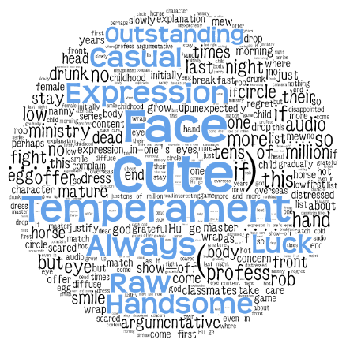
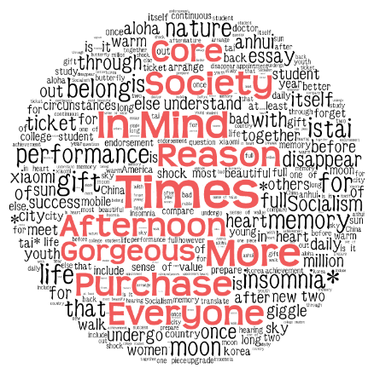
Tweets
Text matters!
High in Conscientiousness:
Formal words in Journalese,
such as “era” and “society”
Low in Conscientiousness:
Informal words, such as single characters or typical cyberwords.
Pearson Correlation
Top 2,000 correlated words.
Clustering
Top 1,500 Chinese words and all punctuations in word-embedding format.
K-means to cluster
Notes:
First, let’s talk about Tweet texts.
Previous work has proved that tweets is expressive to personality measurement. For example, our data shows a user is responsible, he would like to use words such as “era” and “society”.
Based on this obeservation, we extract different aspects of text features. For example, we compute Pearson correlation between words and personality and select the top 2000 words

Slide 11
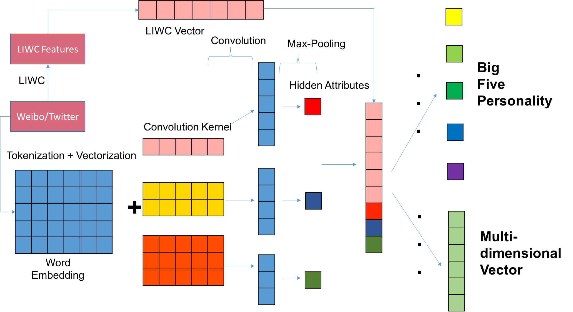
Text-CNN
Notes:
In addition, to model the sequential dependency of tweet sentence, we also use deep learning, a convolutional network structure to get the semantic representation.

Slide 12

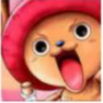


Take their avatars as an instance.
Introverts
Introverts tend to cover their face or show side face.
Extroverts
Extroverts are more likely to use cartoon avatars.
High in Openness
Users high in Openness are more likely to use avatars with their friends.
Low in Openness
Users low in Openness prefer avatars with themselves only.
Notes:
User’s information on social media indeed reveal their personality. Take their avatars for example. In our data, we find that, For extraversion dimension, the introverts tend to cover their face or show side face. And extroverts are more likely to use cartoon avatars. For openness, users have high score are more likely to use avatars with their friends, and users have low score prefer show themselves only.

Slide 13
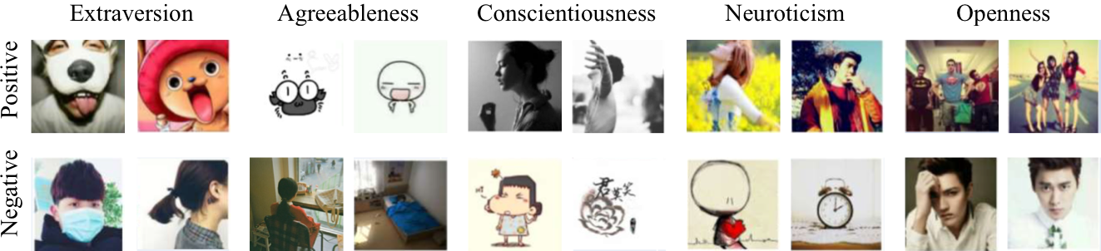
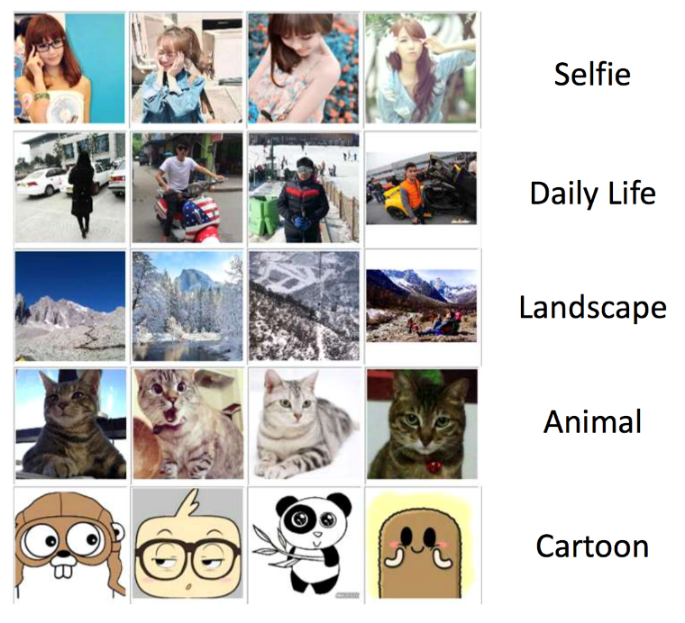
Avatars
Avatars matters!
K-means clustering
with ResNet results
Notes:
To get the image features of avatars, we used a trained ResNet model to get image representation and also a K-means clustering results.

Slide 14
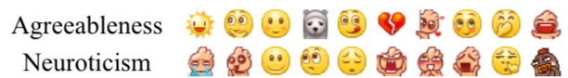
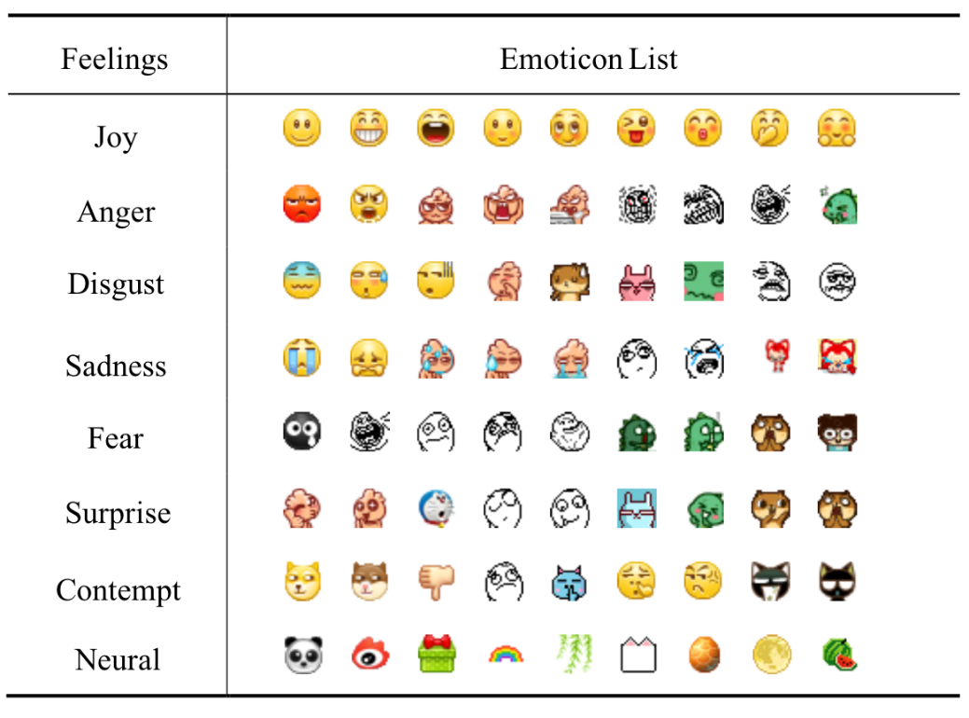
Emoticons
Emoticon matters!
Agreeable users: smile emoticons
Emotionally unstable users: theatrical emoticons to their feelings
Pearson Correlation
Emotion Mapping
Notes:
Emoticons is also useful for personality measurement. Agreeable users frequently smile emoticons.
We extract two emoticon features, the first is compute Pearson correlation and select the top emoticons. The second is mapping emoticon to emotion and then use emotion as category features.

Slide 15
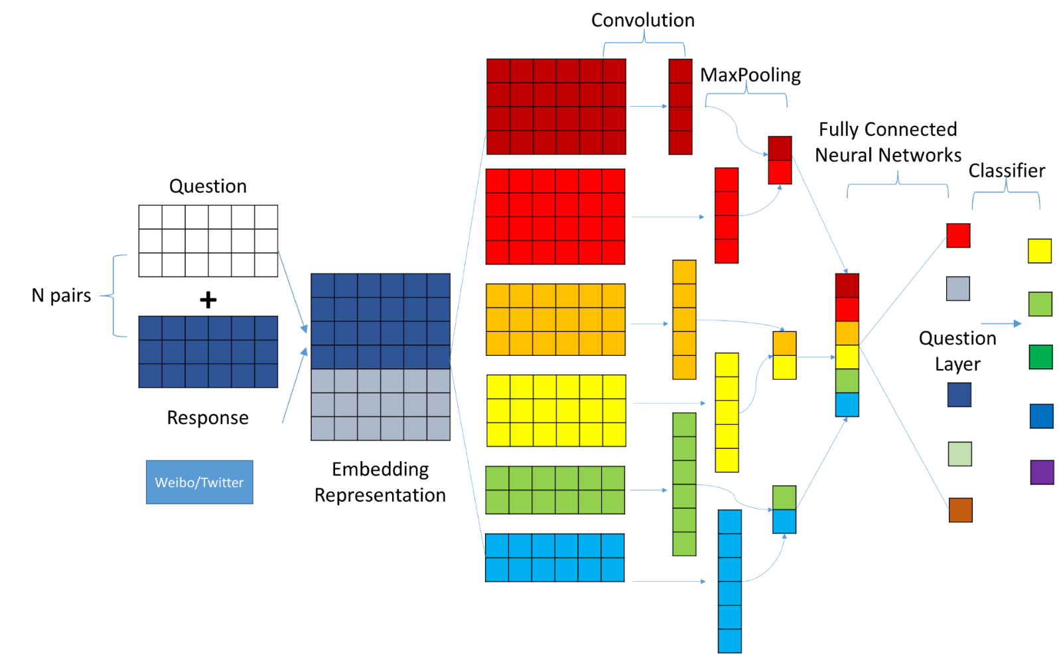
Responsive Pattern
Responsive pattern matters!
user i tweets a message and his/her fans or followers make
user i retweets others’ message
user i makes comment on others’ message
Responsive-CNN
Notes:
How you interacts with other user also reveal your personality.
We extract user tweet-response pair and then use a convolutional network structure to model the interaction representation.

Slide 16
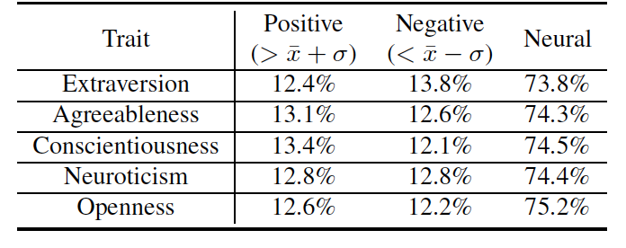
Evaluation
Personality Segmentations
Top or bottom scores in personality traits
Measure accuracy and precision (as accurate as possible VS as much as possible)
Finding the right user is usually far more important than finding as many users as possible in most application scenarios.
Notes:
OK, in the experiment, we split the dataset, use 70% for training and the rest for testing. First, for each dimension in Big Five, we group users into three categories by segmenting the Gaussian distribution.
Next, we measure the total accuracy as well as the precision for each group. We ignore recall metric since precision is more important in many scenarios, finding out the right user is far more important than finding as many users as possible.

Slide 17
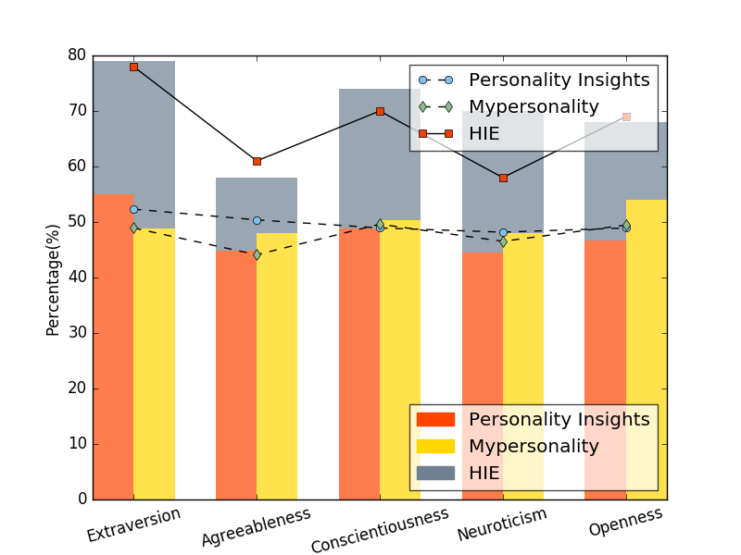
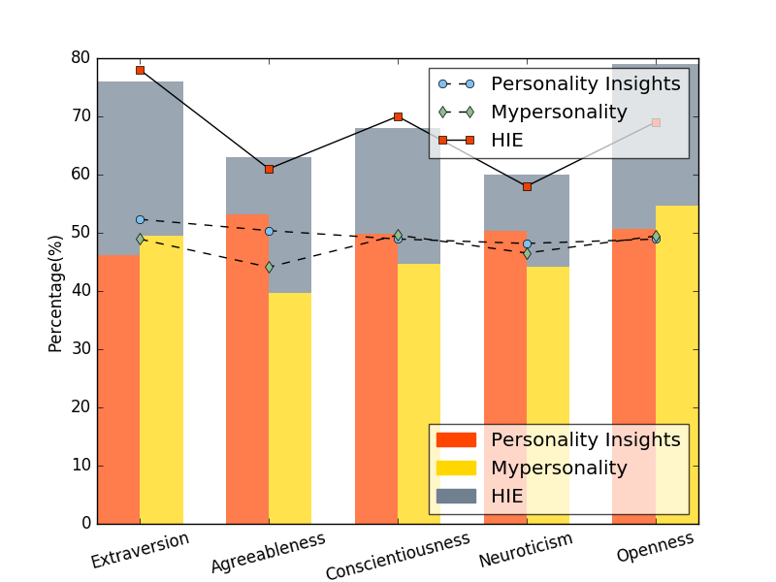
Performance and Comparison
Baseline
IBM Watson Personality Insights
Mypersonality
Raise EPR@P by 61.49% when making predictions on Extraversion.
Notes:
We compare our method with two baselines, and the results show our method beat baselines in different cases. For example, for the precision of user group high in extraversion, our method is about 60% better than baselines.

Slide 18
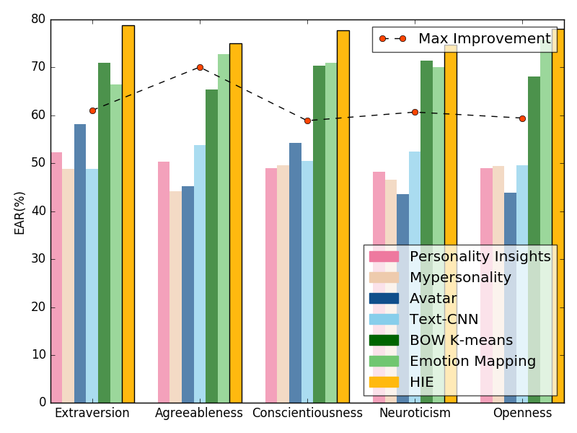
Advantages of HIE
Increasing Performance given more features .
Notes:
We also show that in our framework, give mores heterogeneous features, the performance will be better.

Slide 19


Slide 20
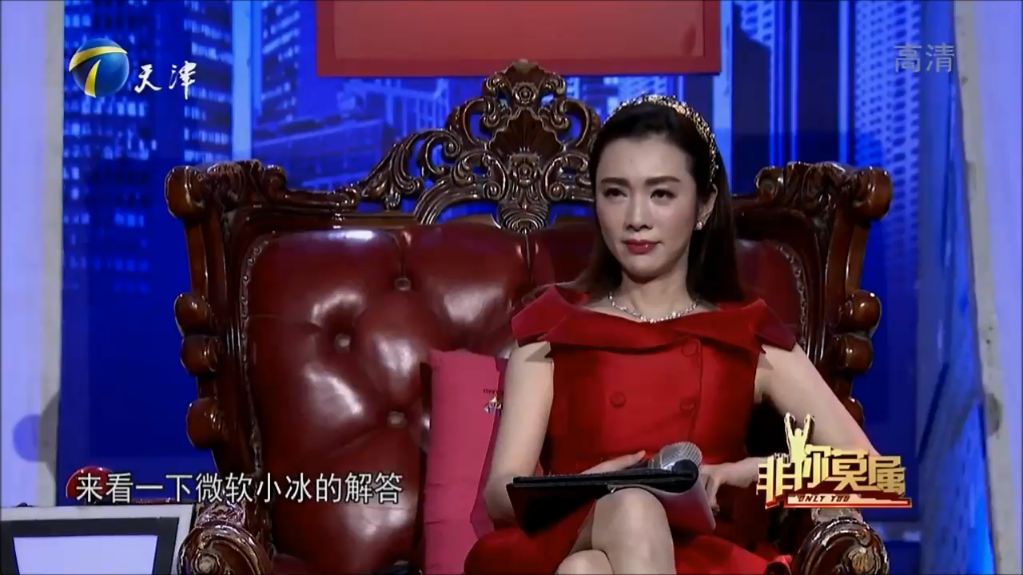

Slide 21


Slide 22
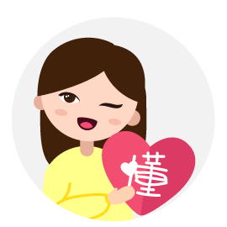
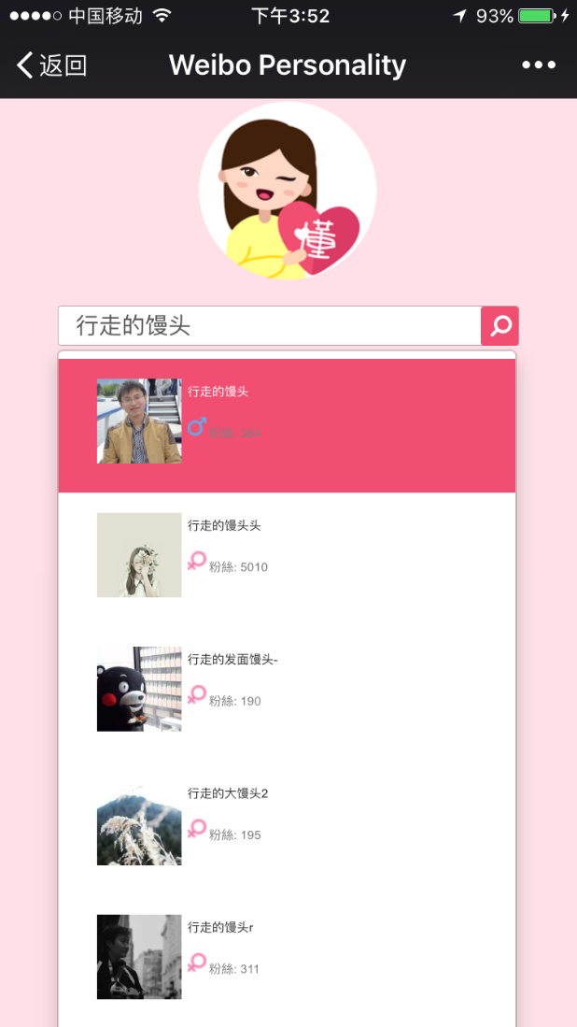
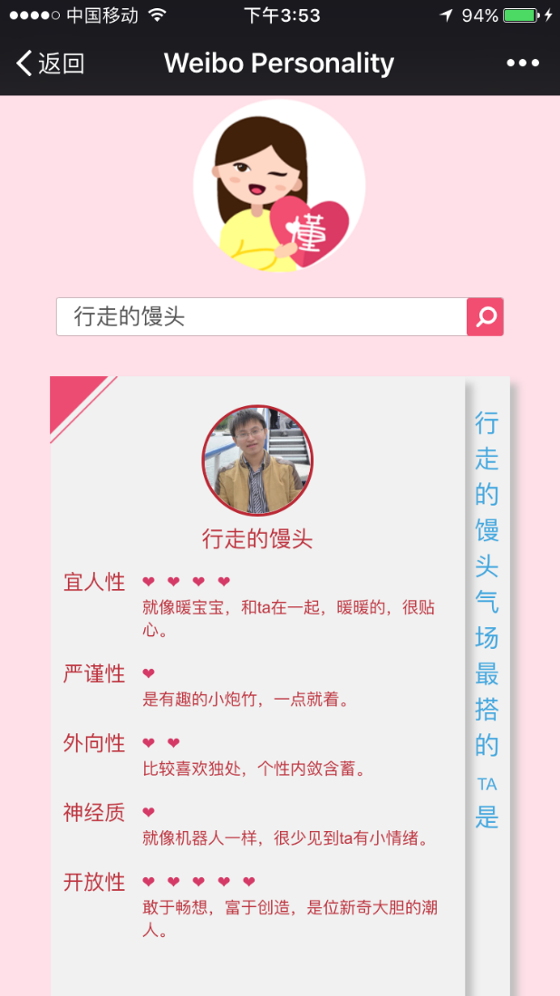
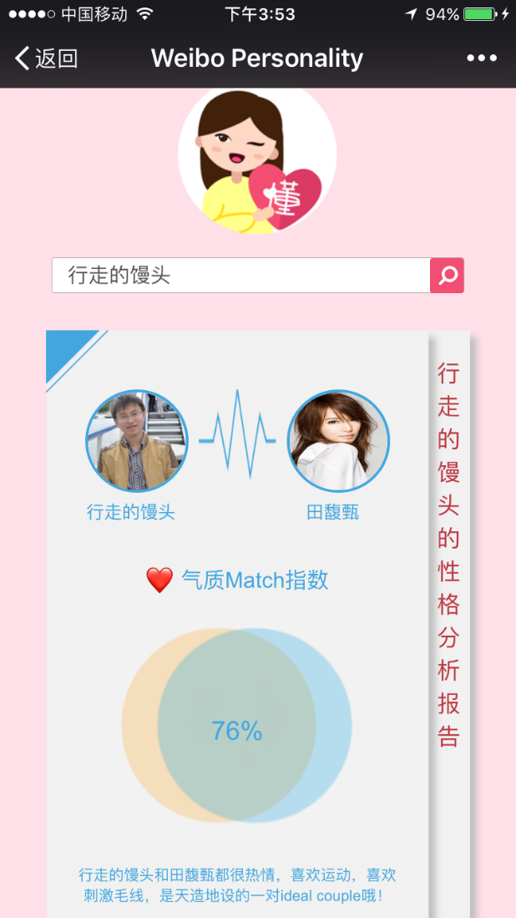
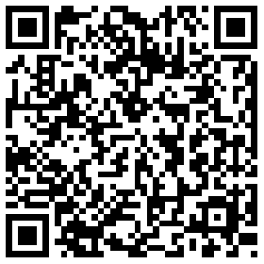
Application: Miss Known
Notes:
Based on our work, we also build a demo called Miss Known. It’s target for SinaWeibo platform, which is a twitter-like social media website. When you input you screen name in our demo, we will collect your heterogeneous information on SianWeibo, and then measure your personality. What is more, we will also find out a star who has the best personality match for you. Sorry that the demo currently only has Chinese version, since our training data is limited to Chinese. If you are interested, you can have a try.
Slide 1:
One out of four people in the world are affected by mental disorders according to a recent WHO report. We aim at building a digital psychologist called DiPsy who served as a personalized chatbot to evaluate, diagnose, and treat users' mental processes through natural conversations. In addition to conversation logs, DiPsy also considers users’ behavioral data such as tweets on social networks as well as users psychical movements. DiPsy can drive the conversation in a natural and effective way in order to study users’ mental process and diagnose their' psychological traits (such as Big-5 personality and MBTI Types). After using DiPsy for some time, we can generate a psychological profile for the user. It is also possible to use DiPsy to examine users’ mental disorders (such as depression and autism) and conduct cognitive behavioral therapy (CBT) or early intervention to help at-risk users alleviate/manage their problems by changing the way they think and behave in a variety of therapeutic contexts.
This digital psychologist can be used for both consumer and enterprise. DiPsy creates a new paradigm for human resources management, which provides a more natural to 1) help organizations profile employees based on their psychological traits, 2) guide the team structuring for a better team chemistry and productivity, and 3) coach employees for mental health care as a daily basis.
Slide 2:
As shown in the figure, DiPsy runs as a typical chatbot. We have a background chat engine to conduct chit-chat with users. Given users’ input, DiPsy will decide whether the input can be used to perform psychological diagnosis and help generate the response for guiding new conversations. If the input text is not relevant for psychological diagnosis, a chit-chat response will be generated using the background chat engine. After a certain rounds of conversations during a certain period, DiPsy can generate the psychological profiles combining the results from both psychological diagnosis and behavioral data collected using our LifeSpec data platform, which was introduced in earlier TechFest.
Slide 3:
The key technology of DiPsy is the computational model to perform psychological diagnosis such as personality test.
(add descriptions)
Slide 4:
The diagnosis component of DiPsy is rooted from several fundamental theories in psychology. E.g.,
(add descriptions for these theories)
Recent studies have shown that computational models for psychological test are as accurate as self-report questionnaires. Sometimes the computational models are even more stable and ubiquitous.
This project is our effort towards pushing the limit of computational psychology by bridging state-of-the-art computational models with psychological theories.

Slide 23
Summary
Propose HIE, a new personality measurement framework
Using heterogeneous information in users’ digital traces
Self-language usage, Avatar, Emoticon and Responsive pattern on social media
Design various feature engineering strategies
Applications: MissKnown
Notes:
In summary, first, we propose HIE, a new personality measurement framework. This framework uses heterogeneous information on social media. Second, we design and combine various feature engineering strategies. Finally, we also implement a demo called MissKnown based on our personality framework.

Slide 24

Notes:
So this is our work, any questions?

Slide 25

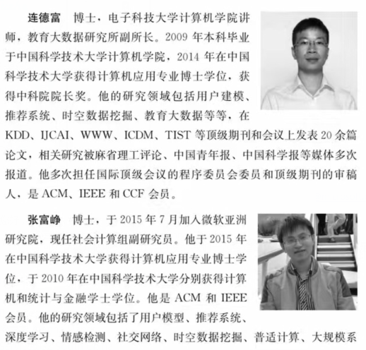
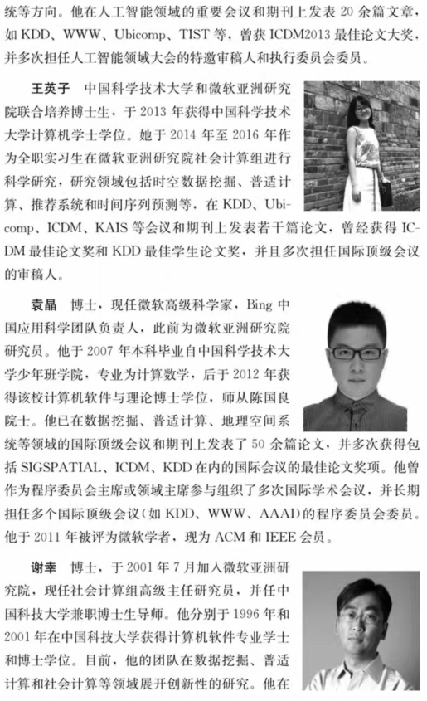

Notes:
这本书梳理总结了作者团队过去十年在人群移动数据理解上展开的研究，包括移动数据预处理、用户移动建模、用户画像以及地点推荐等内容。这些内容很多都曾在数据挖掘领域的顶级国际会议和期刊发表，甚至获得过会议最佳论文奖。

